Slide 1
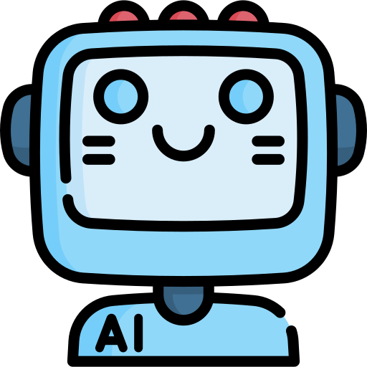
CECS451 - Introduction to AI
Tic Tac Toe with Alpha/Beta Pruning
Bich-Tram Pham, Dimpal Shah, Jocelyn Gonzalez, Jose Jimenez, Ruby Nguyen
Group 3

Slide 2
Why Tic Tac Toe?
Game of perfect information
Finite set of possible moves
States of game are given
No element of chance
Notes:
Tic-tac-toe is considered a perfect information game for game-playing AI development because it is a game with a finite set of possible moves, each player has complete information about the state of the game, and there is no element of chance involved, making it testbed for developing and testing game-playing AI algorithms

Slide 3
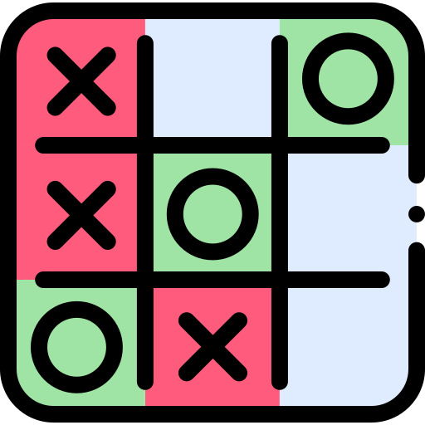
Design Overview
1
Determine Game State
Game board, rules, winning conditions, etc.
2
Implement Optimization Techniques to AI bot
Minimax, Alpha/Beta Pruning
3
Testing
Effectiveness & Evaluation Function

Slide 4
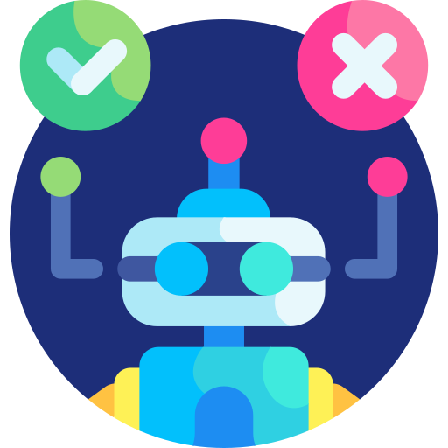
Methods
Class abp
gameBoard()
player()
bot()
checkingForWinner()
abpmm()
Call functions to determine best move for the bot
emptySpaces()

Slide 5
abpmm(board, depth, alpha, beta, player)
board
The game’s current situation
depth
The searchable depth of the game tree
alpha
The maximizer's top score so far, the initial value being set at negative infinity
beta
The minimizer’s top score so far, the initial value being set at positive infinity
player
Depending on whose turn it is, set to 1 (human player) or -1 (the bot)

Slide 6
abpmm(board, depth, alpha, beta, player)
1
Determine if current board has a winner
checkingForWinner()
2
Recursively call itself till maximum depth is attained
emptySpaces()
3
Using Minimax & alpha/beta pruning in each potential move and assigns a score

Slide 7
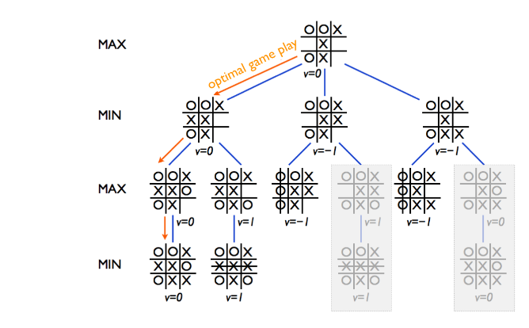
Minimax & Alpha Beta Pruning in Tic Tac Toe
From reference 3.

Slide 8
Max Win Value = 1
Min Win Value = -1
Draw Value = 0
From reference 3.
Notes:
Algo plays out all the scenario where the player gonna plays out

Slide 9
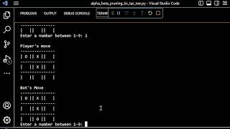
Demo

Slide 10
Testing & Evaluation
 | Human 1 | Human 2 | Human 3
Human Wins | 0 | 0 | 0
Bot Wins | 3 | 1 | 2
Draws | 7 | 9 | 8
Total | 10 | 10 | 10
Results of 30 Test Runs of Tic Tac Toe Program
Notes:
After 30 test runs with three different human users, we saw the bot won 70% of the games, while the user had no wins. The results also concluded with 30% draws from the 30 test runs. The computer’s ability to select the most optimal moves to win the game renders it virtually unbeatable, and any victory by a human player may indicate a flaw in the algorithm's implementation.

Slide 11
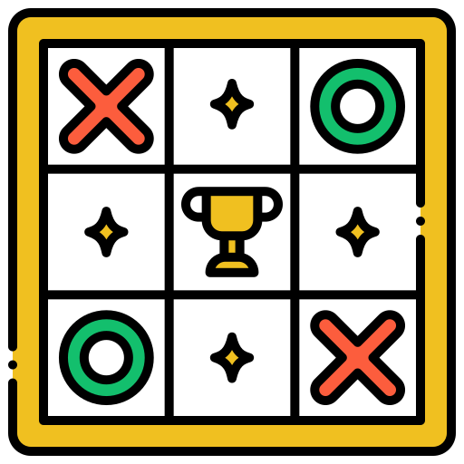

Conclusion
Minimax & Alpha/Beta pruning help the computer be unbeatable in Tic-Tac-Toe
Further research in game-playing AI will help
Advance AI research
Game development
Real world application: logistic, schedule, planning
Notes:
After 30 test runs with three different human users, we saw the bot won 70% of the games, while the user had no wins. The results also concluded with 30% draws from the 30 test runs. The computer’s ability to select the most optimal moves to win the game renders it virtually unbeatable, and any victory by a human player may indicate a flaw in the algorithm's implementation.

Slide 12
Bibliographical references
[1] B. T. Pham, D. Shah, J. Gonzalez, J. Jimenez, R. Nguyen. (2023, May 1). CECS-451-Final-Project [Online]. Available: https://github.com/rubynguyen2505/CECS451-Final-Project
[2] D. Higginbotham, “An exhaustive explanation of minimax, a staple AI algorithm,” Flying Machine Studios, 10-Jan-2012. [Online]. Available: https://www.flyingmachinestudios.com/programming/minimax/#:~:text=The%20minimax%20algorithm%20is%20used,to%20see%20all%20possible%20moves. [Accessed: 01-May-2023].
[3] “Games,” Introduction to Artificial Intelligence 2017. [Online]. Available: https://materiaalit.github.io/intro-to-ai-17/part2/. [Accessed: 01-May-2023].
[4] “Python oops concepts,” GeeksforGeeks, 14-Jun-2022. [Online]. Available: https://www.geeksforgeeks.org/python-oops-concepts. [Accessed: 30-Apr-2023].
[5] R. D. Vishwakarma, C. E. Gudumotu. (2023, Feb. 28). CECS451-ISA/Lab_02_28_2023/alpha_beta_pruning [Online]. Available: https://github.com/rahvis/CECS451-ISA/tree/main/Lab_02_28_2023/alpha_beta_pruning

Slide 13
Thank You

